Slide 1
Java & JEE Training Day 2 – Elements of the Java Language

Slide 2
Java & JEE Training – Day 2 Agenda
Quick review of last class
Breaking down the Hello World program
Built-in Data Types
Conditional statements
Loops
Introduction to String manipulation in Java

Slide 3
Java & JEE Training – Day 2 Agenda
Quick review of last class
Breaking down the Hello World program
Built-in Data Types
Conditional statements
Loops
Introduction to String manipulation in Java

Slide 4
Quick review of last class

Slide 5
Java & JEE Training – Day 2 Agenda
Quick review of last class
Breaking down the Hello World program
Built-in Data Types
Conditional statements
Loops
Introduction to String manipulation in Java

Slide 6
Breaking down the “Hello World” Program

Slide 7
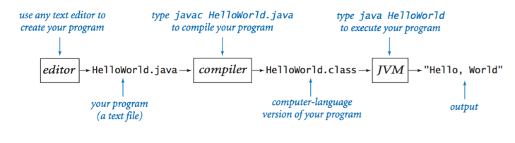
Java programming process

Slide 8
Exercise
Write a program TenHelloWorlds.java that prints "Hello, World" ten times.

Slide 9
3 Types of Errors in Programming
Most errors are easily fixed by carefully examining the program as we create it, in just the same way as we fix spelling and grammatical errors when we type an e-mail message.
Compile-time errors. These errors are caught by the system when we compile the program, because they prevent the compiler from doing the translation (so it issues an error message that tries to explain why).
Run-time errors. These errors are caught by the system when we execute the program, because the program tries to perform an invalid operation (e.g., division by zero).
Logical errors. These errors are (hopefully) caught by the programmer when we execute the program and it produces the wrong answer. Bugs are the bane of a programmer's existence. They can be subtle and very hard to find.

Slide 10
Providing Input to the HelloWorld program
Typically, we want to provide input to our programs: data that they can process to produce a result. The simplest way to provide input data is illustrated.
Whenever this program is executed, it reads the command-line argument that you type after the program name and prints it back out to the terminal as part of the message.

Slide 11
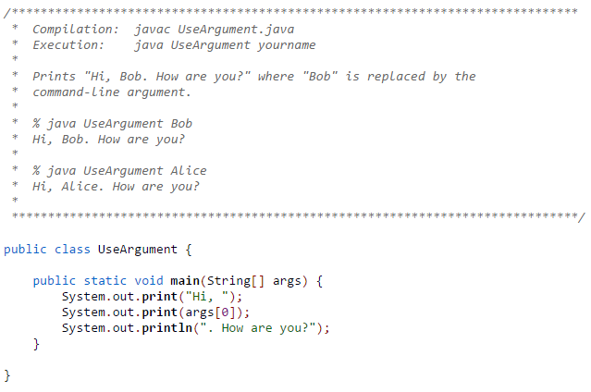
Providing Input to the HelloWorld program

Slide 12
Exercise
Modify UseArgument.java to make a program UseThree.java that takes three names and prints out a proper sentence with the names in the reverse of the order given,
so that for example, "java UseThree Alice Bob Carol" gives "Hi Carol, Bob, and Alice.".

Slide 13
Exercise
Write a program TenHelloWorlds.java that prints "Hello, World" n times, where n is input by the user.

Slide 14
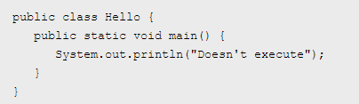
Exercise – What is the output?

Slide 15
Java & JEE Training – Day 2 Agenda
Quick review of last class
Breaking down the Hello World program
Built-in Data Types
Conditional statements
Loops
Introduction to String manipulation in Java

Slide 16
Built-in Data Types

Slide 17
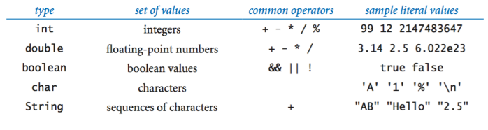
Commonly Used Built-in Data Types

Slide 18
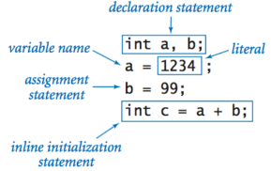
Declaration and Assignment Statements

Slide 19
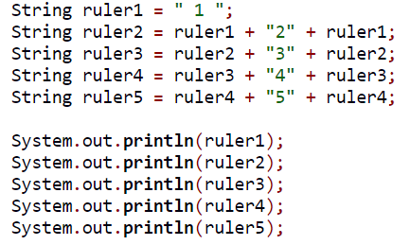
Exercise: What is the output?

Slide 20
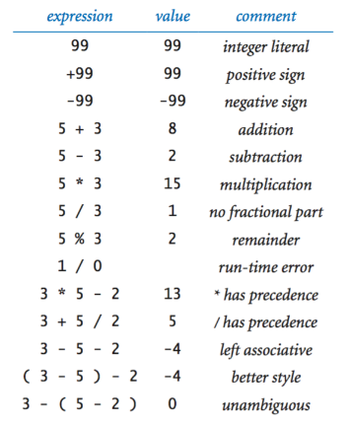
Integers - Exercise

Slide 21
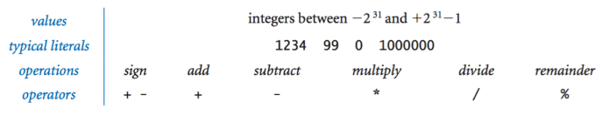
Integers

Slide 22
Integers – Exercise – Try these…

Slide 23
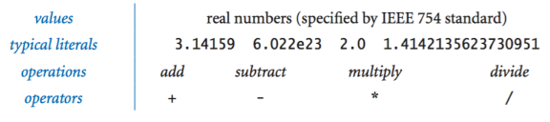
Floating Point Numbers: double

Slide 24
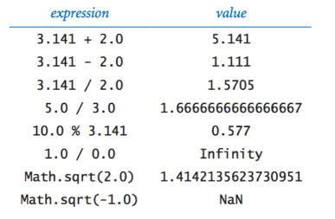
Floating Point Numbers: Exercise – Try these..

Slide 25
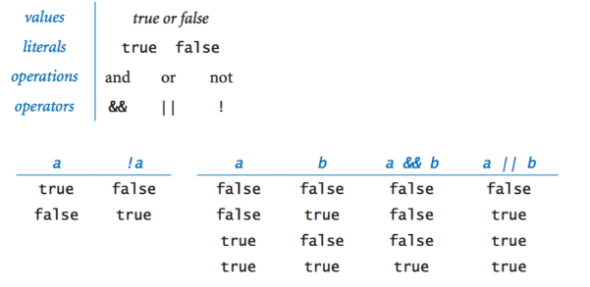
Booleans

Slide 26
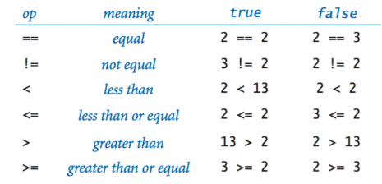
Comparison Operators

Slide 27
Exercise – Leap Year
Write a program to check if provided year is leap year or not.

Slide 28
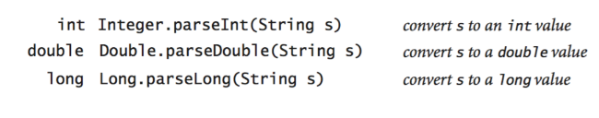
Parsing Command Line Arguments (Converting Strings to Primitives)

Slide 29
Type Conversion
We often find ourselves converting data from one type to another using one of the following approaches.
Explicit type conversion. Call methods such as Math.round(), Integer.parseInt(), and Double.parseDouble().
Automatic type conversion. For primitive numeric types, the system automatically performs type conversion when we use a value whose type has a larger range of values than expected.
Explicit casts. Java also has some built-in type conversion methods for primitive types that you can use when you are aware that you might lose information, but you have to make your intention using something called a cast.
Automatic conversions for strings. The built-in type String obeys special rules. One of these special rules is that you can easily convert any type of data to a String by using the + operator.

Slide 30
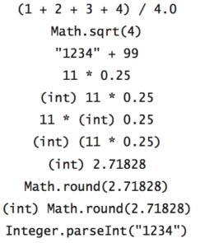
Exercise: Evaluate the following

Slide 31
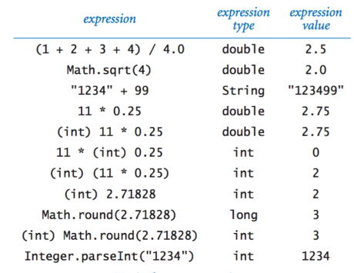
Exercise: Evaluate the following - Answers

Slide 32
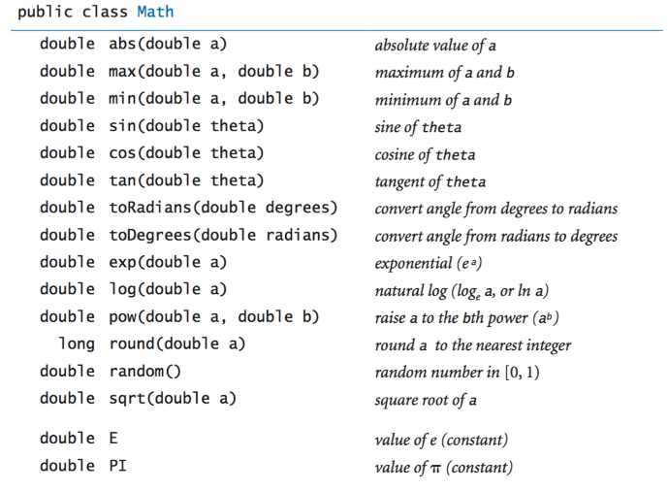
Mathematical Functions

Slide 33
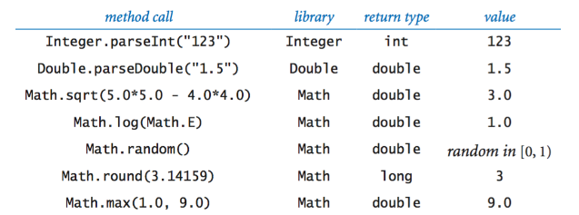
Mathematical Functions: Examples

Slide 34
Exercise: Random Integer
Read an integer command-line argument n and print a "random" integer between 0 and n−1.
Hint: Use Math.random()

Slide 35
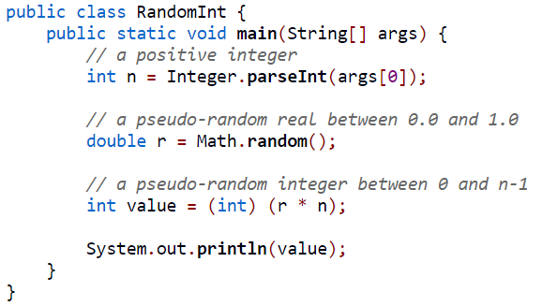
Exercise: Random Integer
Read an integer command-line argument n and print a "random" integer between 0 and n−1.
Hint: Use Math.random()

Slide 36
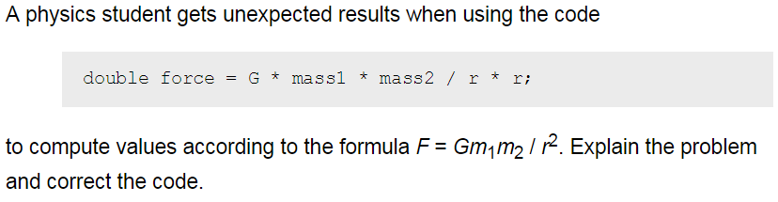
Exercise

Slide 37


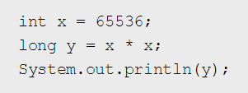
Exercise: What is the output?

Slide 38
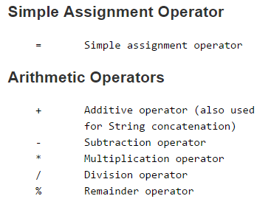
Summary of Operators

Slide 39
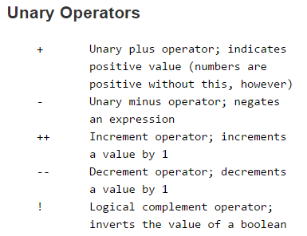
Summary of Operators

Slide 40
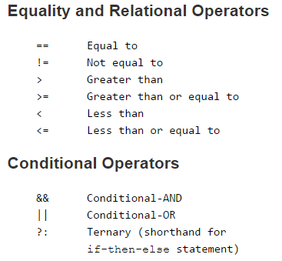
Summary of Operators

Slide 41
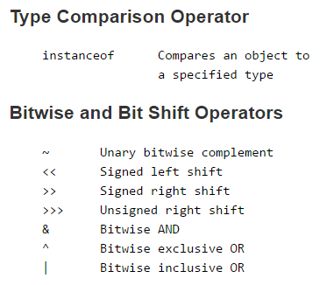
Summary of Operators

Slide 42
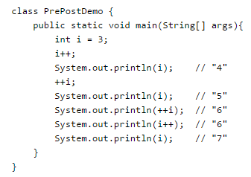
Exercise – What is the output?
In the following program, explain why the value "6" is printed twice in a row:

Slide 43
What is the output?
Consider the following code snippet.
int i = 10;
int n = i++%5;
What are the values of i and n after the code is executed?
What are the final values of i and n if instead of using the postfix increment operator (i++), you use the prefix version (++i))?

Slide 44


Write unambiguous expressions…

Slide 45
Write unambiguous expressions…

Slide 46
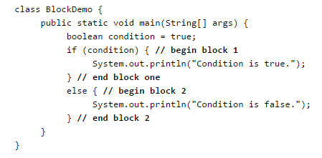
Importance of Blocks in Code
A block is a group of zero or more statements between balanced braces and can be used anywhere a single statement is allowed. The following example, BlockDemo, illustrates the use of blocks:

Slide 47
Java & JEE Training – Day 2 Agenda
Quick review of last class
Breaking down the Hello World program
Built-in Data Types
Conditional statements
Loops
Introduction to String manipulation in Java

Slide 48
Conditional Statements

Slide 49
Conditional Statements
if
if-else
if-else ladder
switch-case
Ternary operator

Slide 50
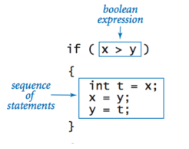
if

Slide 51
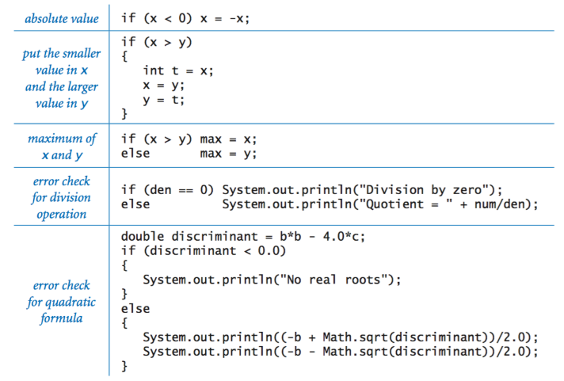
if and if-else examples

Slide 52
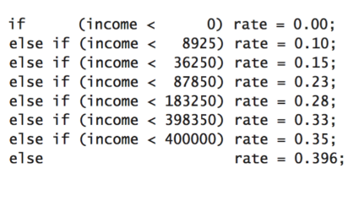
if-else ladder

Slide 53
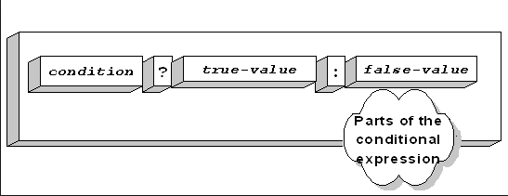
Ternary Operator

Slide 54
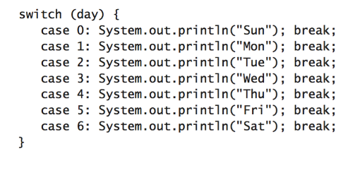
Switch…case statement
Unlike if-then and if-then-else statements, the switch statement can have a number of possible execution paths. A switch works with the byte, short, char, and int primitive data types. It also works with enumerated types (discussed in Enum Types), the String class, and a few special classes that wrap certain primitive types: Character, Byte, Short, and Integer (discussed in Numbers and Strings).
* Provide default value – it is a good practice.
* The break is important. Don’t forget it.

Slide 55
Exercise
Use Math.random() and an if-else statement to print the results of a coin flip.

Slide 56
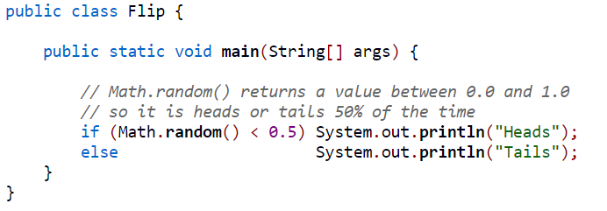
Exercise
Use Math.random() and an if-else statement to print the results of a coin flip.

Slide 57
Exercise
Write two programs - one using switch case and another using if else ladder to print the full name of a month provided that the user inputs an integer between 1 to 12.
E.g. if the user inputs 1, print January.

Slide 58
Java & JEE Training – Day 2 Agenda
Quick review of last class
Breaking down the Hello World program
Built-in Data Types
Conditional statements
Loops
Introduction to String manipulation in Java

Slide 59
Loops

Slide 60
Loops
while
do..while
for

Slide 61
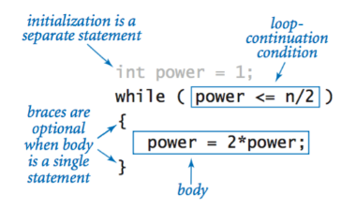
while

Slide 62

do-while

Slide 63
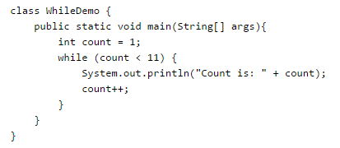
Exercise – what is output?

Slide 64

Exercise – what is the output?

Slide 65
Difference between while and do-while?
Do-while loop is always executed at least once, as the condition is checked at the end of the loop.

Slide 66
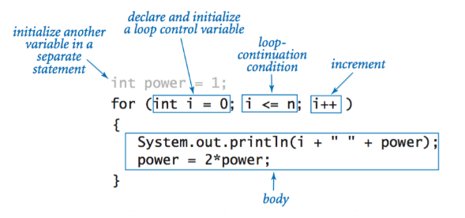
for statement

Slide 67
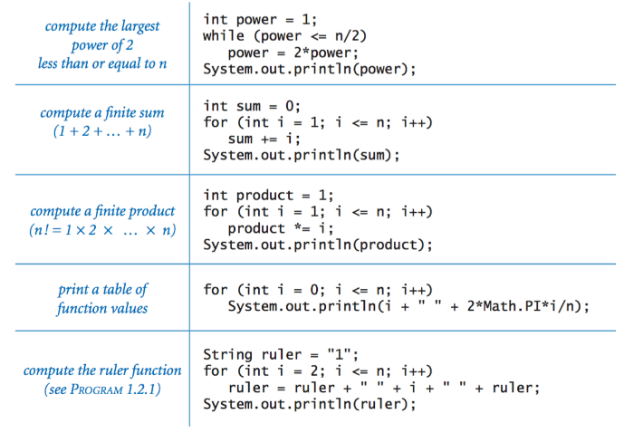
Loop Examples

Slide 68
Branching Statements: Break, Continue and Return…
Break:
The break statement has two forms: labeled and unlabeled. You saw the unlabeled form in the previous discussion of the switch statement. You can also use an unlabeled break to terminate a for, while, or do-while loop
An unlabeled break statement terminates the innermost switch, for, while, or do-while statement, but a labeled break terminates an outer statement.

Slide 69
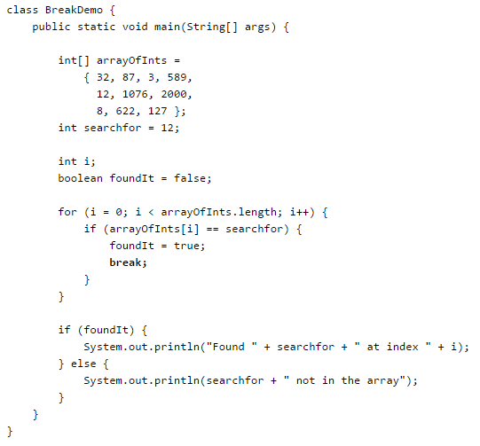
Break statement: Example (Without Label)

Slide 70
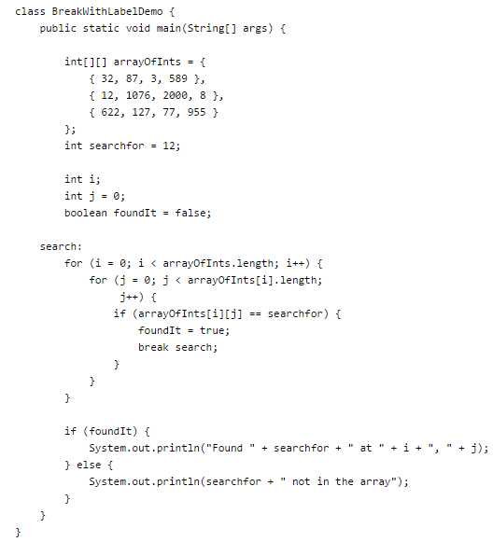
Break statement: Example (With Label)

Slide 71
Branching Statements: Break, Continue and Return…
Continue:
The continue statement skips the current iteration of a for, while , or do-while loop.
The unlabeled form skips to the end of the innermost loop's body and evaluates the boolean expression that controls the loop.
The following program, ContinueDemo , steps through a String, counting the occurences of the letter "p". If the current character is not a p, the continue statement skips the rest of the loop and proceeds to the next character. If it is a "p", the program increments the letter count.

Slide 72
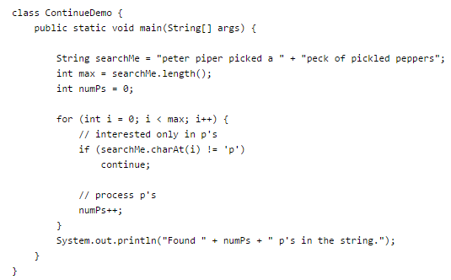
Continue Statement: Example (Without Label)

Slide 73
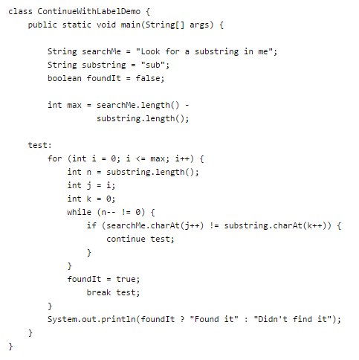
Continue Statement: Example (Without Label)

Slide 74
Branching Statements: Break, Continue and Return…
Return:
The last of the branching statements is the return statement. The return statement exits from the current method, and control flow returns to where the method was invoked. The return statement has two forms: one that returns a value, and one that doesn't. To return a value, simply put the value (or an expression that calculates the value) after the return keyword.
return ++count;
The data type of the returned value must match the type of the method's declared return value. When a method is declared void, use the form of return that doesn't return a value.
return;

Slide 75

Exercise: What is the output?

Slide 76
Exercise
Consider the following code snippet.
if (aNumber >= 0)
if (aNumber == 0)
System.out.println("first string");
else System.out.println("second string");
System.out.println("third string");
What output do you think the code will produce if aNumber is 3?
Write a test program containing the previous code snippet; make aNumber 3. What is the output of the program? Is it what you predicted? Explain why the output is what it is; in other words, what is the control flow for the code snippet?
Using only spaces and line breaks, reformat the code snippet to make the control flow easier to understand.
Use braces, { and }, to further clarify the code.

Slide 77
Exercise
Print 10 HelloWorld using different kinds of loops

Slide 78
Exercise
Write a program to print all powers of 2 less than or equal to n.

Slide 79
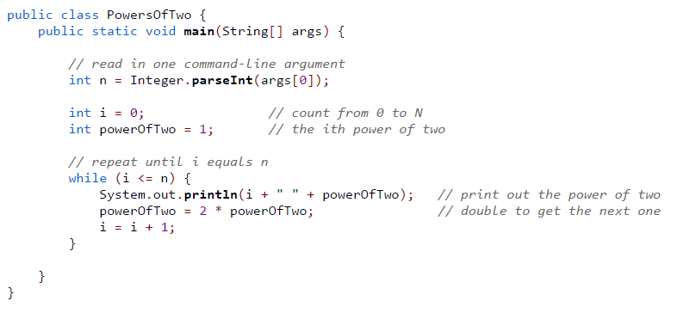
Exercise
Write a program to print all powers of 2 less than or equal to n.

Slide 80
Exercise
Write a program to print the binary equivalent of a decimal integer input by the user.

Slide 81
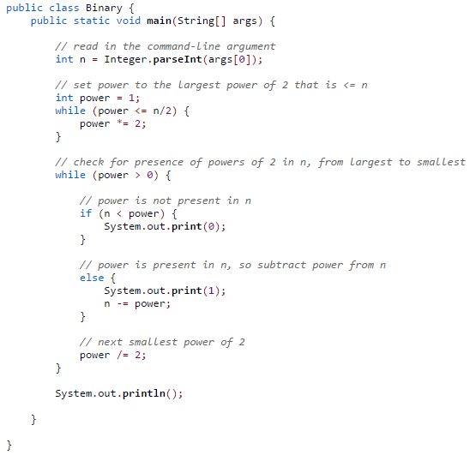
Exercise
Write a program to print the binary equivalent of a decimal integer input by the user.

Slide 82
Exercise
Use conditional operator (ternary operator) to find the least of 3 numbers input by the user.

Slide 83
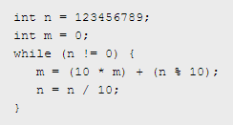
Exercise: What is the value of m and n?

Slide 84
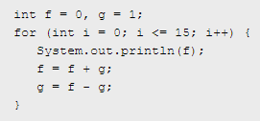
Exercise: What is the output?

Slide 85

Exercise: What’s wrong with this?

Slide 86
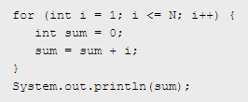
Exercise: What is the output?

Slide 87
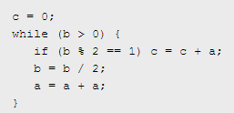
Exercise: What is the output?

Slide 88
Exercise: What is the output?
Answer: a*b

Slide 89
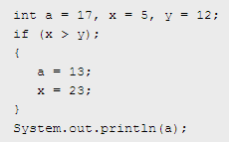
Exercise: What is the output?

Slide 90
Java & JEE Training – Day 2 Agenda
Quick review of last class
Breaking down the Hello World program
Built-in Data Types
Conditional statements
Loops
Introduction to Strings in Java

Slide 91
Introduction to Strings in Java

Slide 92
Strings in Java
Three in-built classes that can be used for Strings…
String
StringBuilder
StringBuffer

Slide 93
String
String is immutable ( once created can not be changed )object . The object created as a String is stored in the Constant String Pool .
Every immutable object in Java is thread safe ,that implies String is also thread safe . String can not be used by two threads simultaneously.
String once assigned can not be changed.
String demo = " hello " ;
// The above object is stored in constant string pool and its value can not be modified.
demo="Bye" ;
//new "Bye" string is created in constant pool and referenced by the demo variable
// "hello" string still exists in string constant pool and its value is not overrided but we lost reference to the "hello"string

Slide 94
StringBuffer
StringBuffer is mutable means one can change the value of the object . The object created through StringBuffer is stored in the heap . StringBuffer has the same methods as the StringBuilder , but each method in StringBuffer is synchronized that is StringBuffer is thread safe . Due to this it does not allow two threads to simultaneously access the same method . Each method can be accessed by one thread at a time . But being thread safe has disadvantages too as the performance of the StringBuffer hits due to thread safe property . Thus StringBuilder is faster than the StringBuffer when calling the same methods of each class. StringBuffer value can be changed , it means it can be assigned to the new value . Nowadays its a most common interview question ,the differences between the above classes . String Buffer can be converted to the string by using toString() method.
StringBuffer demo1 = new StringBuffer("Hello") ; // The above object stored in heap and its value can be changed . demo1=new StringBuffer("Bye"); // Above statement is right as it modifies the value which is allowed in the StringBuffer

Slide 95
StringBuilder
StringBuilder is same as the StringBuffer , that is it stores the object in heap and it can also be modified . The main difference between the StringBuffer and StringBuilder is that StringBuilder is also not thread safe.
StringBuilder is fast as it is not thread safe .
StringBuilder demo2= new StringBuilder("Hello");
// The above object too is stored in the heap and its value can be modified
demo2=new StringBuilder("Bye");
// Above statement is right as it modifies the value which is allowed in the StringBuilder

Slide 96
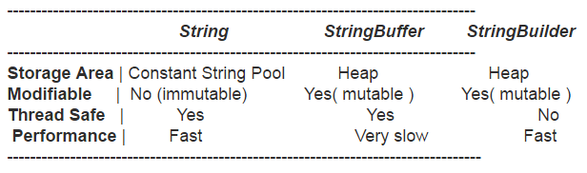
Comparison

